Slide 1




Barium Tagging in Solid Xenon for nEXO
Tim Walton
PhD Defense
2015-12-08
committee:
William Fairbank Robert Wilson
Bruce Berger Alan Van Orden

Slide 2
Outline
Neutrinos and neutrinoless double beta decay
EXO-200 experiment
nEXO and barium tagging
Barium tagging in solid xenon (SXe):
Part 1: Spectroscopy of Ba and Ba+ in SXe
Excitation/emission of Ba in SXe
Temperature dependence
Bleaching
Candidate Ba⁺ lines
Part 2: Imaging Ba atoms in SXe in focused laser
Images of ~10³ atoms w/ 577- and 591-nm lines
Single-atom level imaging w/ 619-nm line

Slide 3
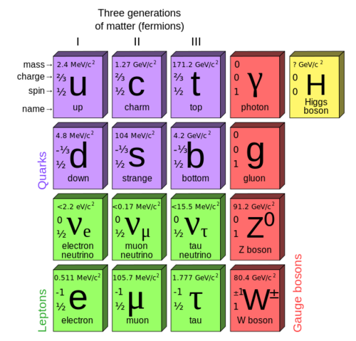
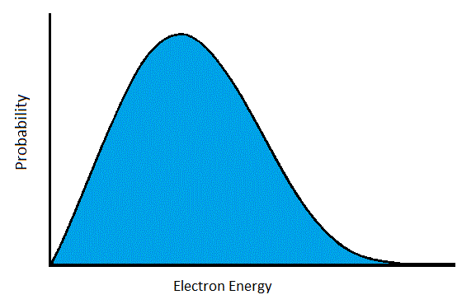
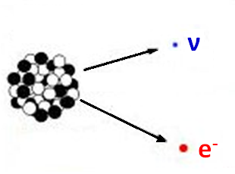
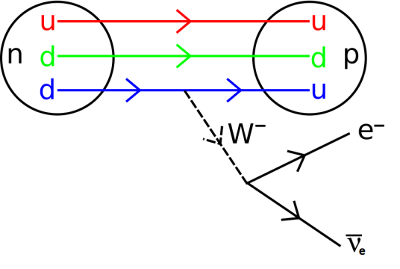
Neutrinos
First indications: beta decay spectrum
Interact only via Weak Force (and Gravity)
Very small mass

Slide 4
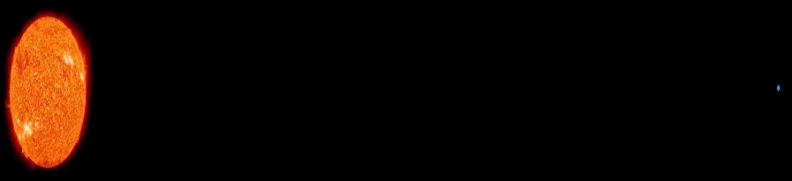
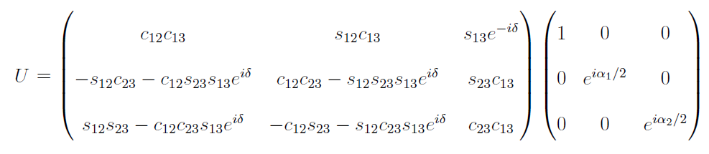
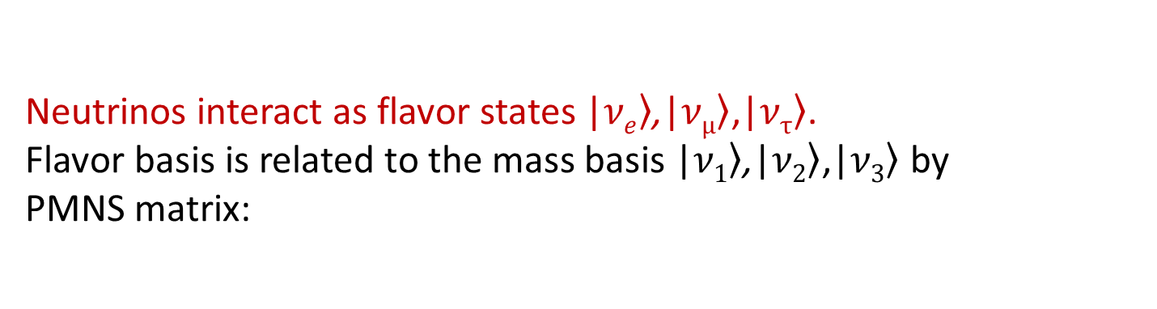
Neutrino oscillation
ν_{e}
ν_{μ}
Neutrinos interact as flavor states |$\left.νe\right\rangle$,|$\left.νμ\right\rangle$,|$\left.ντ\right\rangle$.
Flavor basis is related to the mass basis |$\left.ν1\right\rangle$,|$\left.ν2\right\rangle$,|$\left.ν3\right\rangle$ by
PMNS matrix:
s_{ij} = sin θ_{ij}, c_{ij} = cos θ_{ij}, and δ, α₁, α₂ are CP-violating phases.
With m_{ν} << p_{ν}, time-evolution is determined by mass squared differences Δm₂₁² = m₂² – m₁² and Δm₃₁² = m₃² – m₁².
Neutrino oscillation requires non-zero mass squared differences.

Slide 5
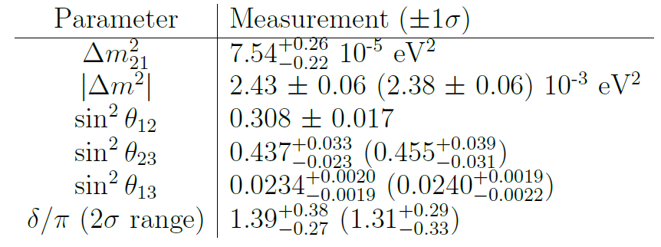
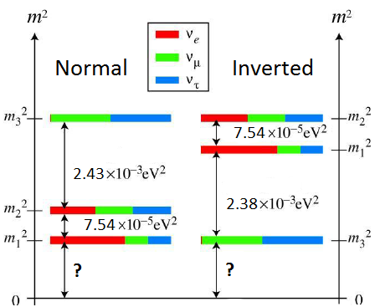
Neutrino oscillation
ν_{e}
ν_{μ}
Neutrino mixing measurements given Normal (Inverted) Hierarchy:
Neutrino Mass Hierarchy
2012 Review by K. Nakamura, U. Tokyo, S.T. Petcov

Slide 6
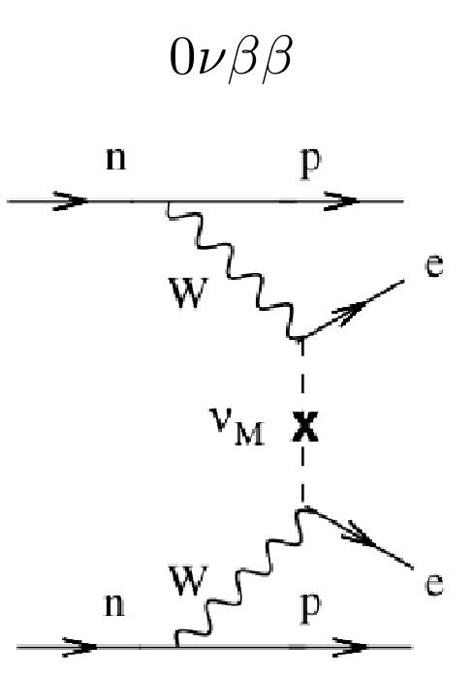
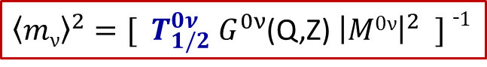
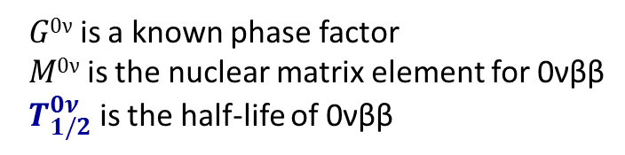
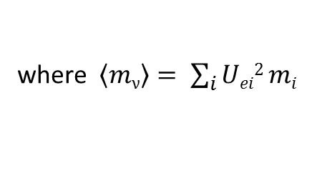
Much yet to learn…
What is the fundamental nature of neutrinos? (Why is their mass so small? Are they Majorana or Dirac particles?)
What is the absolute mass scale of the neutrinos?
Do they violate CP and/or Lepton Number conservation?
A method: search for Neutrinoless Double Beta Decay (0νββ)
Observation of this decay would:
prove that neutrinos are Majorana fermions
measure absolute neutrino mass in the form of effective electron-neutrino mass:
${\left\langle mν\right\rangle }^{2}=[{ T}_{1/2}^{0ν}{ G}_{}^{0ν}$(Q,Z) ${\left|M0ν\right|}^{2} ] ¯1$
where $\left\langle mν\right\rangle = \sum_{i}{Uei2 mi}$
$G0ν$ is a known phase factor
$M0ν$ is the nuclear matrix element for 0νββ
${ T}_{1/2}^{0ν}$ is the half-life of 0νββ

Slide 7
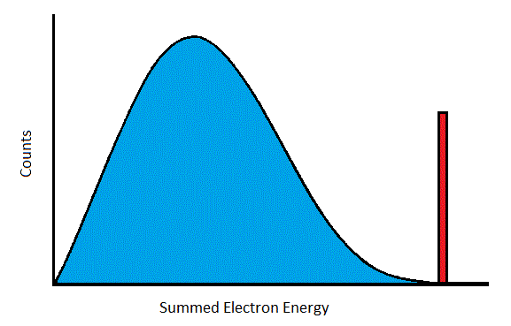
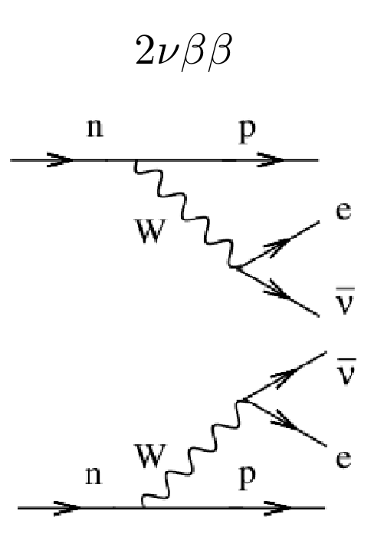
Search for 0νββ
Energy Spectrum Signature
- Predicted by Standard Model
- Observed in many isotopes,
including Xe¹³⁶ in EXO
and KamLAND ZEN
Very rare decay
Very low backgrounds are required

Slide 8
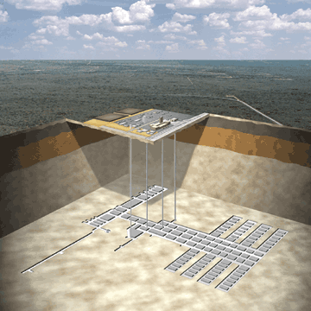
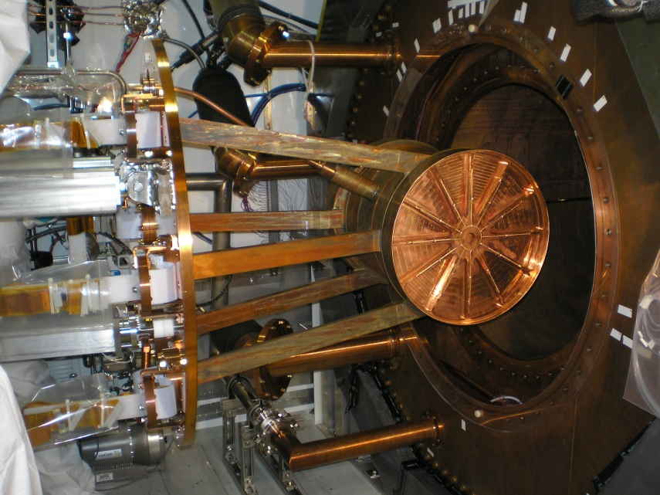
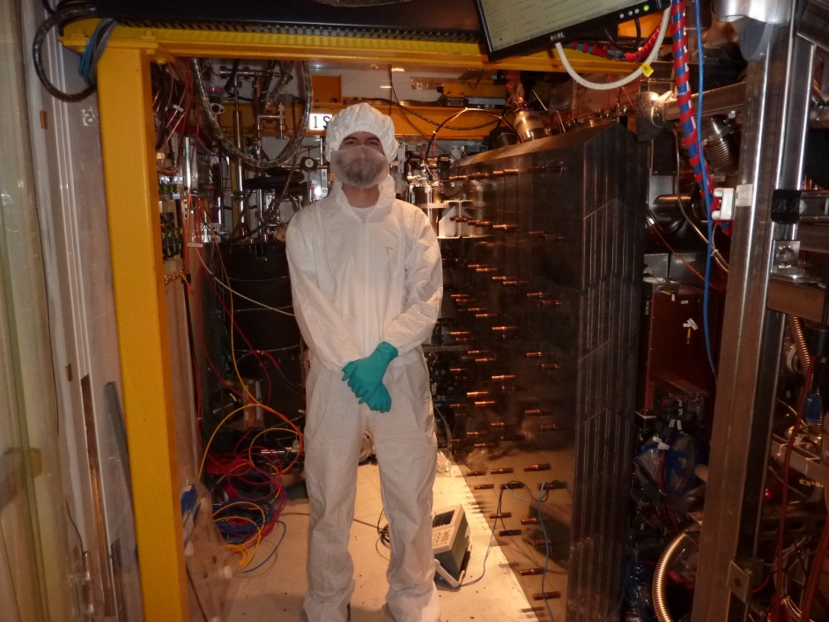
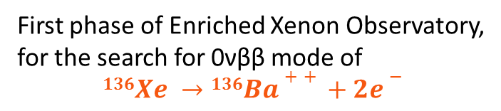
EXO-200
WIPP salt mine
near Carlsbad, NM
First phase of Enriched Xenon Observatory,
for the search for 0νββ mode of
$$136Xe →136Ba++ +2e−$$
~200-kg. liquid Xe (LXe) time projection chamber (TPC), enriched to ~80.6% Xe¹³⁶
operates in class 100 cleanroom, 2,150 ft. underground
TPC installation into copper cryostat

Slide 9
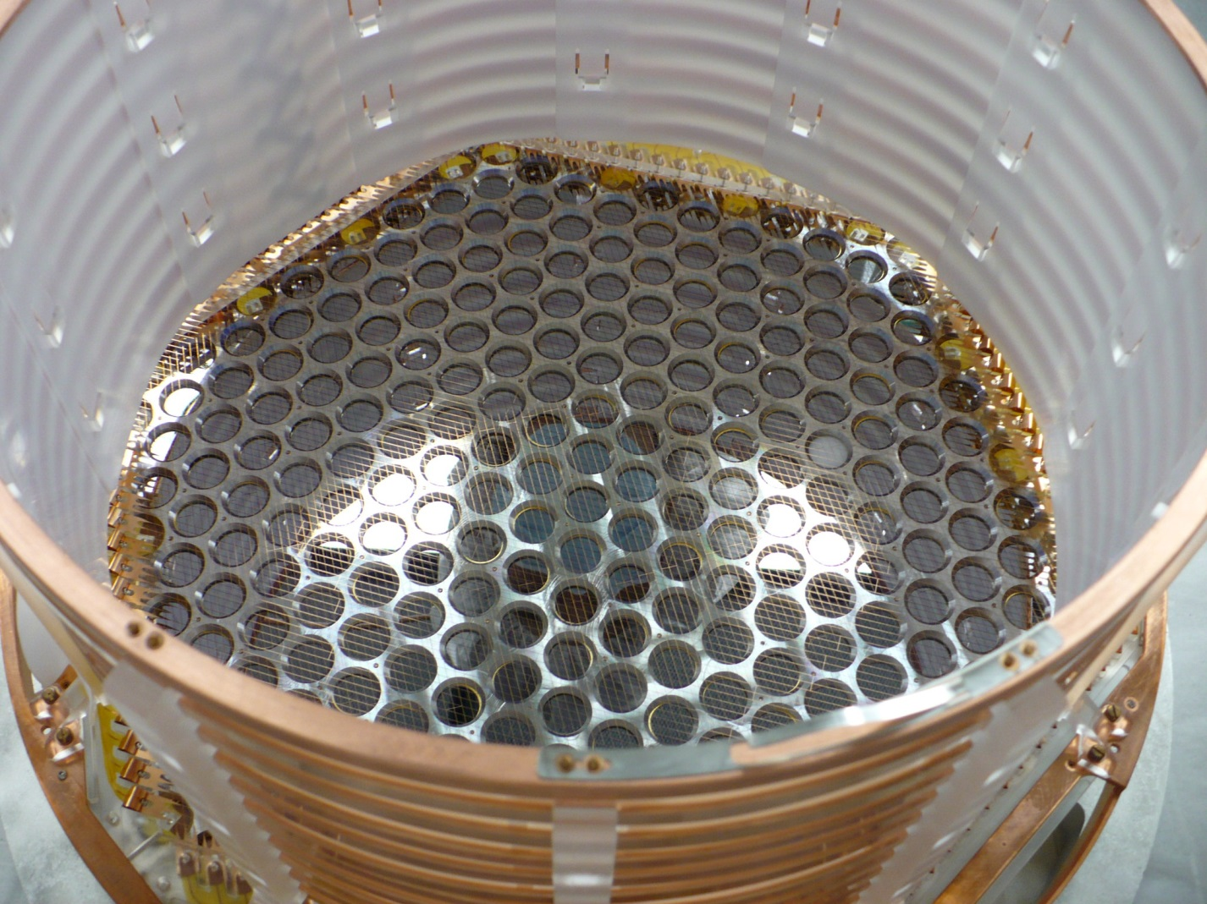
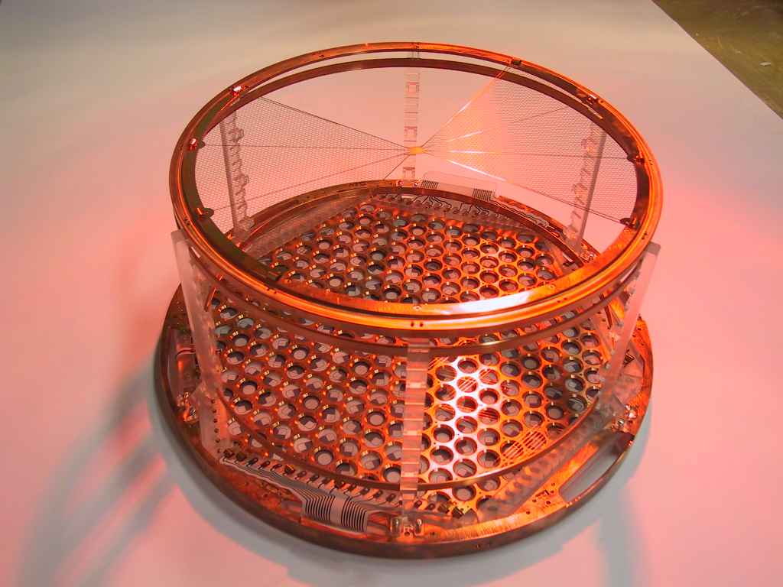
EXO-200 Time Projection Chamber
Cathode grid
Detection plane for
charge (wires) and scintillation
(APDs) from decay events in the LXe

Slide 10
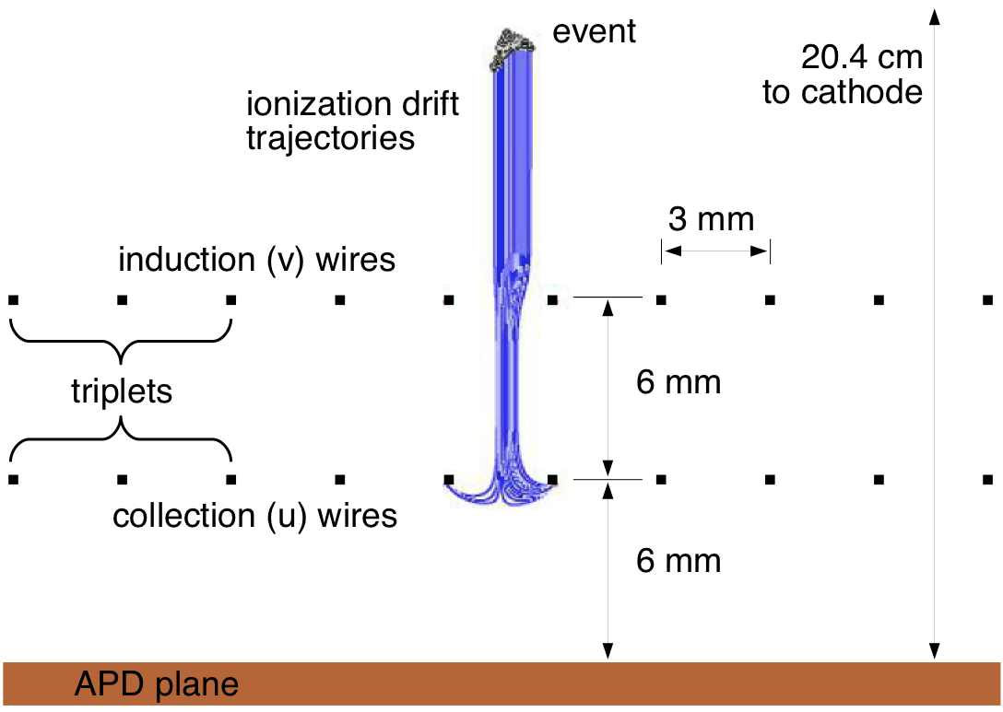
EXO-200 Time Projection Chamber
Liquid Xenon
Cross-hatched “u” and “v” wires give x-y position, u-wires collect ionized charge
Avalanche Photo Diodes (APDs) for scintillation light
Drift time gives z-position
(time between scintillation and charge detection)

Slide 11
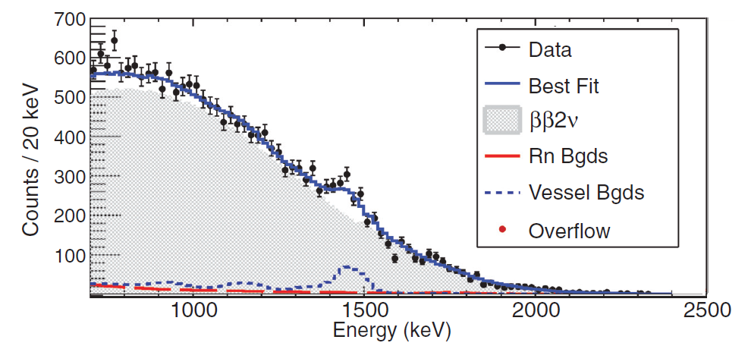
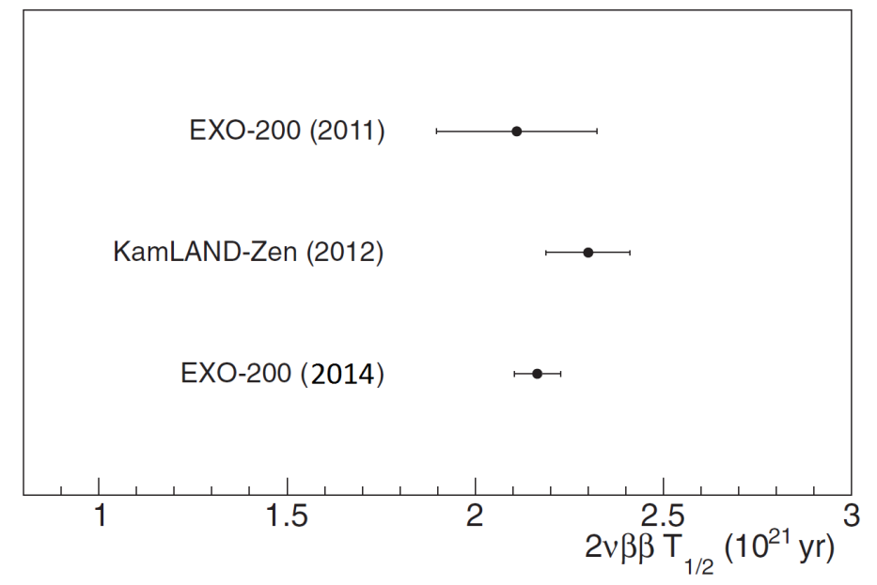
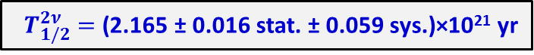
EXO-200 Results: 2νββ Measurement
Phys. Rev. C 89, 015502 (2014)
${ T}_{1/2}^{2ν} =$(2.165 ± 0.016 stat. ± 0.059 sys.)×10²¹ yr

Slide 12
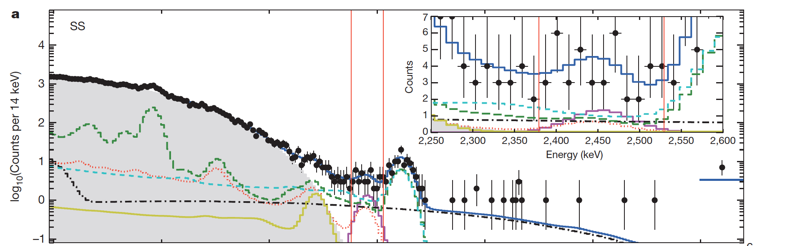
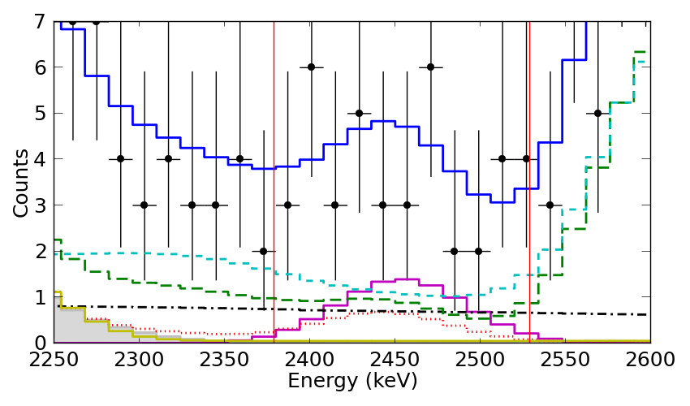
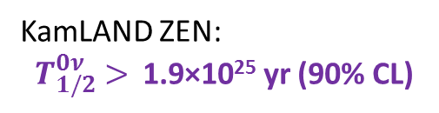
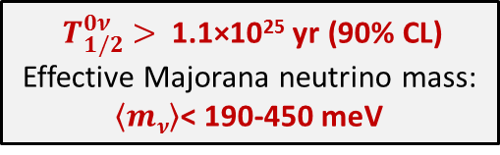
EXO-200 Results: 0νββ Search
Zoom into ±2σ region of interest
# Events from Fit
Backgrounds | 31.1
0νββ decay | 9.9
Total | 41.0
${ T}_{1/2}^{0ν} >$1.1×10²⁵ yr (90% CL)
Effective Majorana neutrino mass:
$\left\langle mν\right\rangle$< 190-450 meV
KamLAND ZEN:
${ T}_{1/2}^{0ν} >$1.9×10²⁵ yr (90% CL)
Nature 510, 229 (2014)

Slide 13
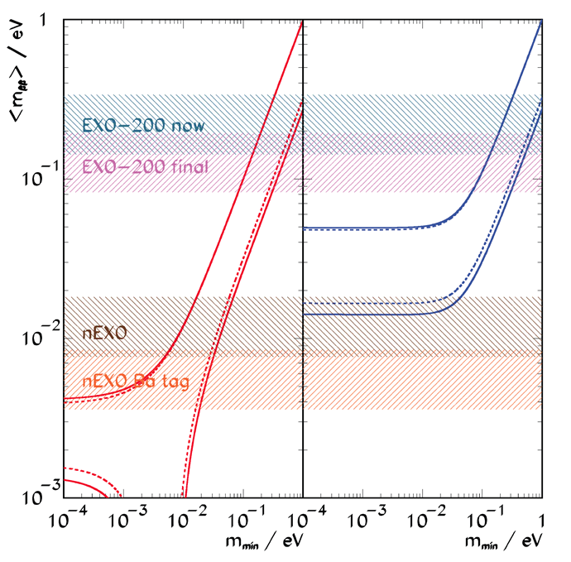
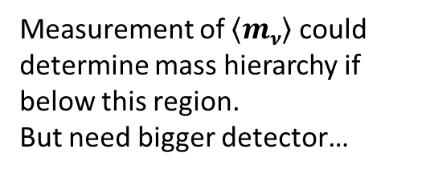
0νββ Sensitivity
Normal Hierarchy
Inverted Hierarchy
Final (2019) EXO-200 sensitivity in “Quasi-degenerate” region of neutrino masses.
Measurement of $\left\langle mν\right\rangle$ could determine mass hierarchy if below this region.
But need bigger detector…

Slide 14
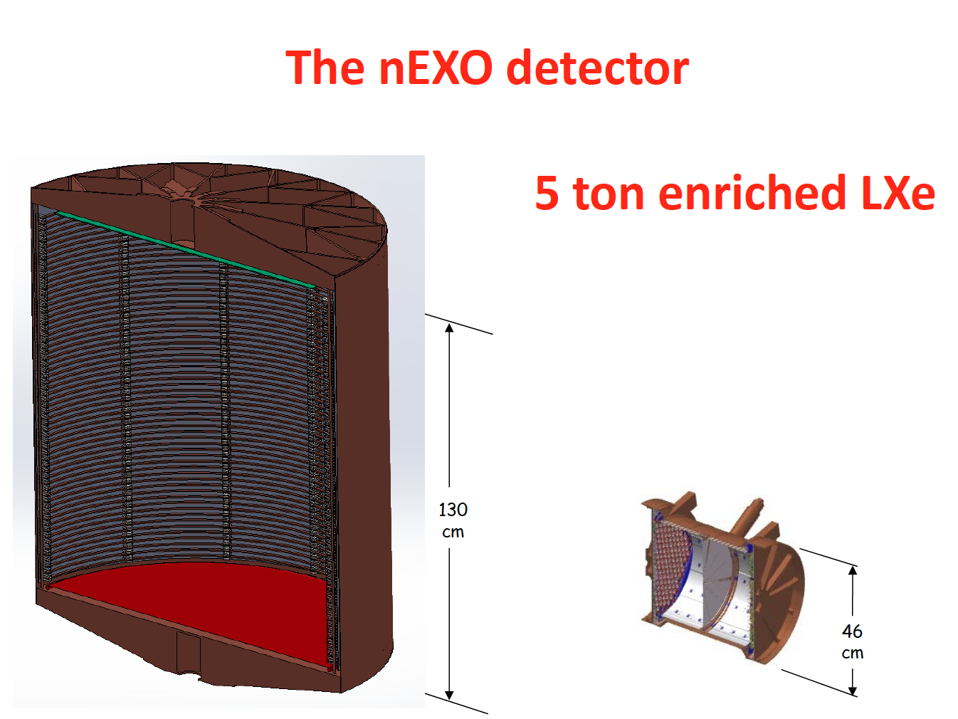
nEXO
Successor to EXO-200: ~5-ton enriched LXe TPC for more sensitive 0νββ search.
EXO-200: 170 kg enriched LXe

Slide 15
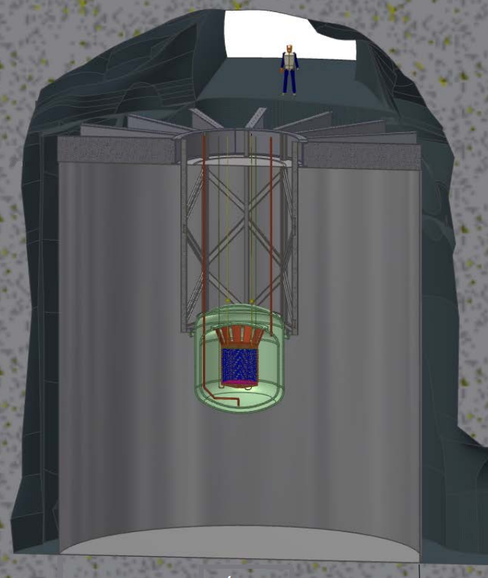
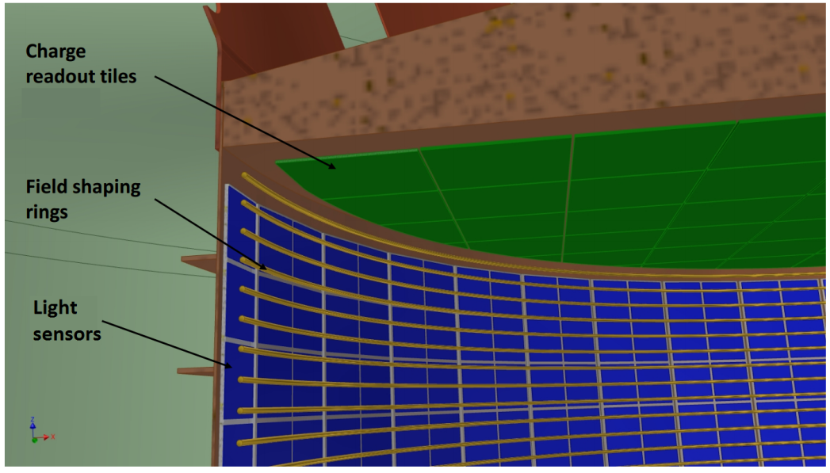
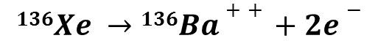
nEXO
Successor to EXO-200: ~5-ton enriched LXe TPC for more sensitive 0νββ search.
Ba tagging: identify barium daughter for complete background elimination
$$136Xe →136Ba++ +2e−$$
Will require grabbing/detecting a single Ba⁺ out of a macroscopic volume of LXe!

Slide 16
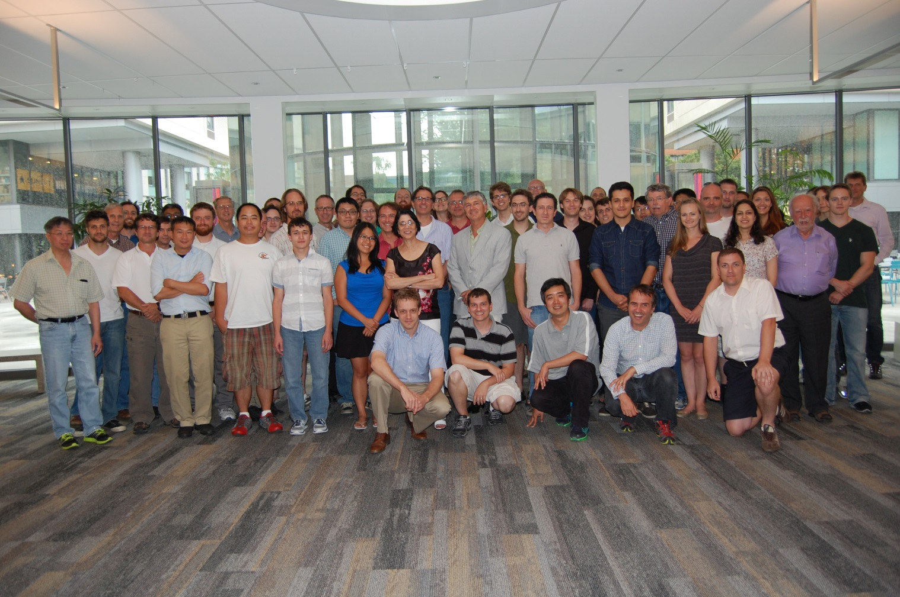








University of Alabama, Tuscaloosa AL, USA — T Didberidze, M Hughes, A Piepke, R Tsang
University of Bern, Switzerland — S Delaquis, R Gornea†, J-L Vuilleumier †Now at Carleton University
Brookhaven National Laboratory, Upton NY, USA — M Chiu, G De Geronimo, S Li, V Radeka, T Rao, G Smith, T Tsang, B Yu
California Institute of Technology, Pasadena CA, USA — P Vogel
Carleton University, Ottawa ON, Canada — Y Baribeau, V Basque, M Bowcock, M Dunford, M Facina, R Gornea, K Graham,
P Gravelle, R Killick, T Koffas, C Licciardi, K McFarlane, R Schnarr, D Sinclair
Colorado State University, Fort Collins CO, USA — C Chambers, A Craycraft, W Fairbank Jr., T Walton
Drexel University, Philadelphia PA, USA — MJ Dolinski, YH Lin, E Smith, T Winick, Y-R Yen
Duke University, Durham NC, USA — PS Barbeau, G Swift
University of Erlangen-Nuremberg, Erlangen, Germany — G Anton, R Bayerlein, J Hoessl, P Hufschmidt, A Jamil, T Michel, T Ziegler
IBS Center for Underground Physics, Daejeon, South Korea — DS Leonard
IHEP Beijing, People’s Republic of China — G Cao, W Cen, X Jiang, H Li, Z Ning, X Sun, T Tolba, W Wei, L Wen, W Wu, J Zhao
University of Illinois, Urbana-Champaign IL, USA — D Beck, M Coon, J Walton, L Yang
Indiana University, Bloomington IN, USA — JB Albert, S Daugherty, TN Johnson, LJ Kaufman, G Visser, J Zettlemoyer
University of California, Irvine, Irvine CA, USA — M Moe
ITEP Moscow, Russia — V Belov, A Burenkov, M Danilov, A Dolgolenko, A Karelin, A Kobyakin, A Kuchenkov, V Stekhanov,
O Zeldovich
Laurentian University, Sudbury ON, Canada — B Cleveland, A Der Mesrobian-Kabakian, J Farine, B Mong, U Wichoski
Lawrence Livermore National Laboratory, Livermore CA, USA — O Alford, J Brodsky, M Heffner, G Holtmeier, A House, M Johnson,
S Sangiorgio
University of Massachusetts, Amherst MA, USA — J Dalmasson, S Feyzbakhsh, S Johnston, J King, A Pocar
McGill University, Montreal PQ, Canada — T Brunner
Oak Ridge National Laboratory, Oak Ridge TN, USA — L Fabris, D Hornback, RJ Newby, K Ziock
Rensselaer Polytechnic Institute, Troy NY, USA — E Brown
SLAC National Accelerator Laboratory, Menlo Park CA, USA — T Daniels,- K Fouts, G Haller, R Herbst, M Kwiatkowski,
K Nishimura, A Odian, M Oriunno, PC Rowson, K Skarpaas
University of South Dakota, Vermillion SD, USA — R MacLellan
Stanford University, Stanford CA, USA — R DeVoe, D Fudenberg, G Gratta, M Jewell, S Kravitz, D Moore, I Ostrovskiy, A Schubert,
K Twelker, M Weber
Stony Brook University, SUNY, StonyBrook, NY, USA — K Kumar, O Njoya, M Tarka
Technical University of Munich, Garching, Germany — P Fierlinger, M Marino
TRIUMF, Vancouver BC, Canada — J Dilling, P Gumplinger, R Krücken, F Retière, V Strickland
The nEXO Collaboration

Slide 17
0νββ Sensitivity
Normal Hierarchy
Inverted Hierarchy
nEXO will probe entire Inverted Hierarchy, and well into Normal Hierarchy with Ba tagging.

Slide 18
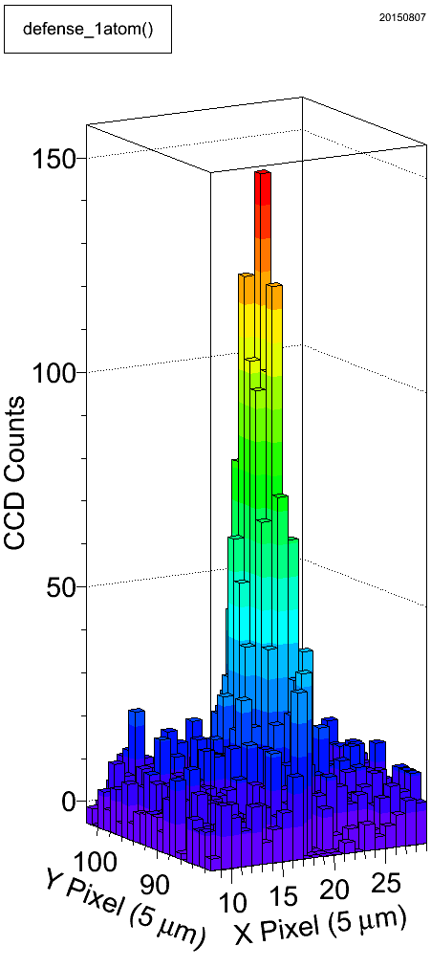
Barium Tagging in Solid Xenon
laser
fiber
Cold probe
≤ 1 Ba atom in SXe in focused laser
CCD
liquid Xe TPC
solid Xe
Ba⁺ ion
Oνββ decay
Ba⁺ ion
solid Xe

Slide 19
Barium Tagging in Solid Xenon
Requires:
Position of 2β decay known (TPC)
Understanding of Ba/Ba⁺ fluorescence in solid xenon
Detection sensitivity at single atom/ion level

Slide 20
Barium Tagging in Solid Xenon
Requires:
Position of 2β decay known (TPC)
Understanding of Ba/Ba⁺ fluorescence in solid xenon
Detection sensitivity at single atom/ion level

Slide 21
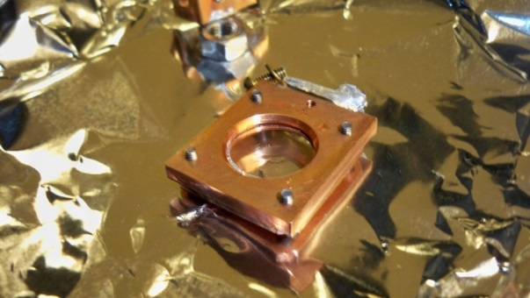
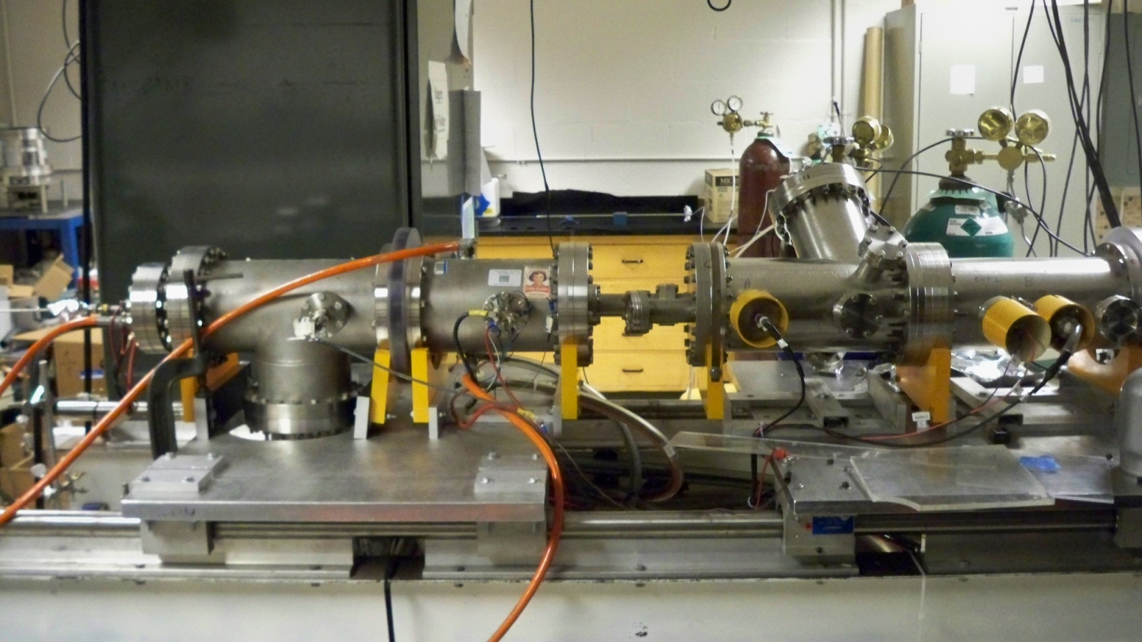
Ion Beam
for depositing Ba⁺ ions into Solid Xenon
Ba⁺ ion
source
2000 V
EхB
mass filter
pulsing
plates
Sapphire
Window
Faraday cup
Faraday cup
Decelerator
deflection
plates
deflection
plates
deflection
plates
Einzel Lens
Acceleration/
Einzel Lens
Einzel Lens
induction plates

Slide 22
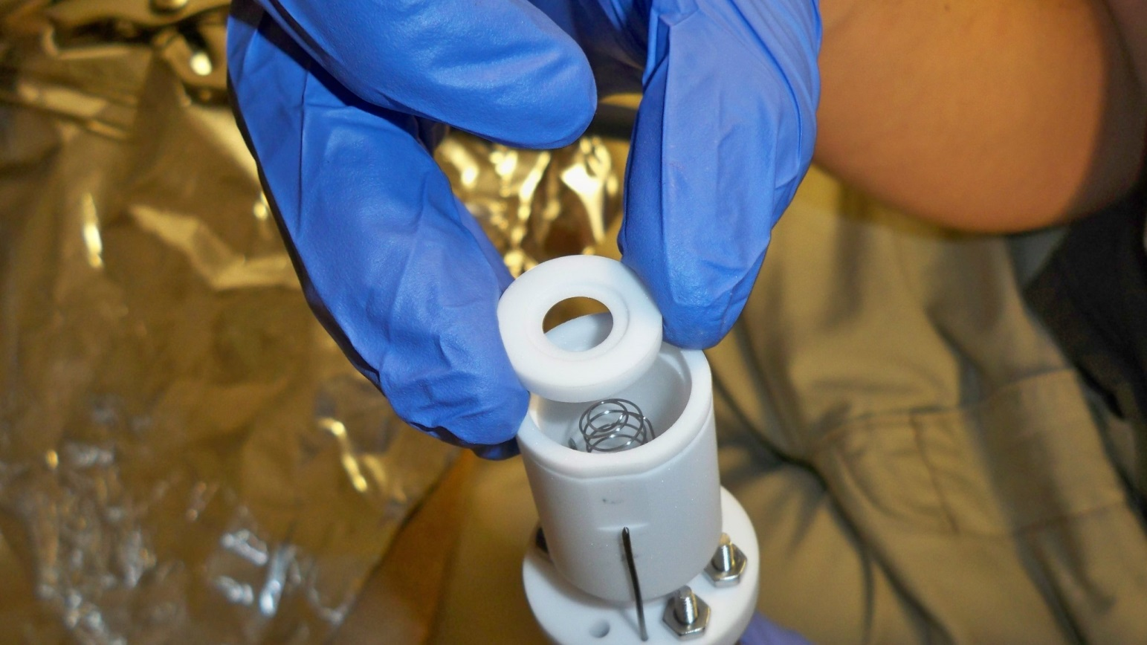
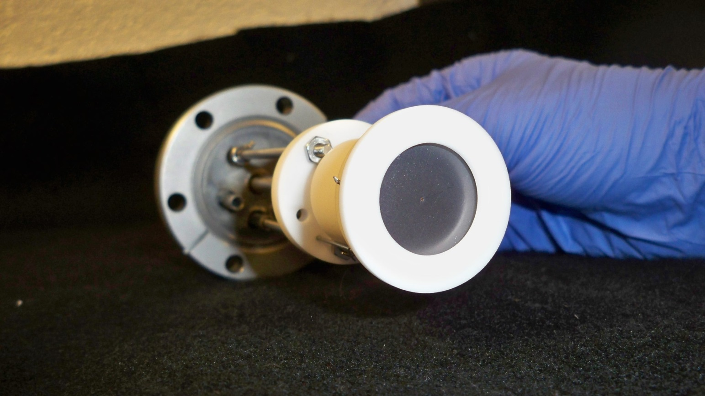
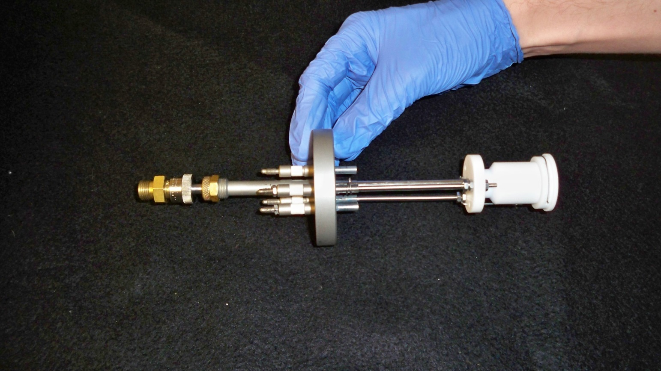
Ion Source
hot filament/cathode
Barium source
Ba+ ions
anode

Slide 23
E x B Mass Filter for selecting Ba⁺
N
Only ions with velocity satisfying
qE = qvB
will move through filter undeflected, thus selecting specific m/q, which have different velocities due to initial acceleration.
ion beam
Electrode “shims” for shaping E-field
-
+
S

Slide 24

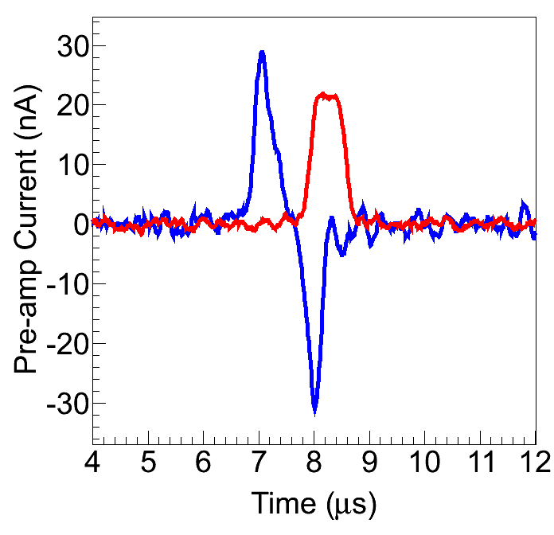
Ba⁺/Ba Deposition
Induction Plates
Pulsed Ba⁺
Ion Beam
Faraday Cup
Sapphire Window (11 K)
Faraday cup is calibrated to calculate
Ions/Area
Pulse

Slide 25
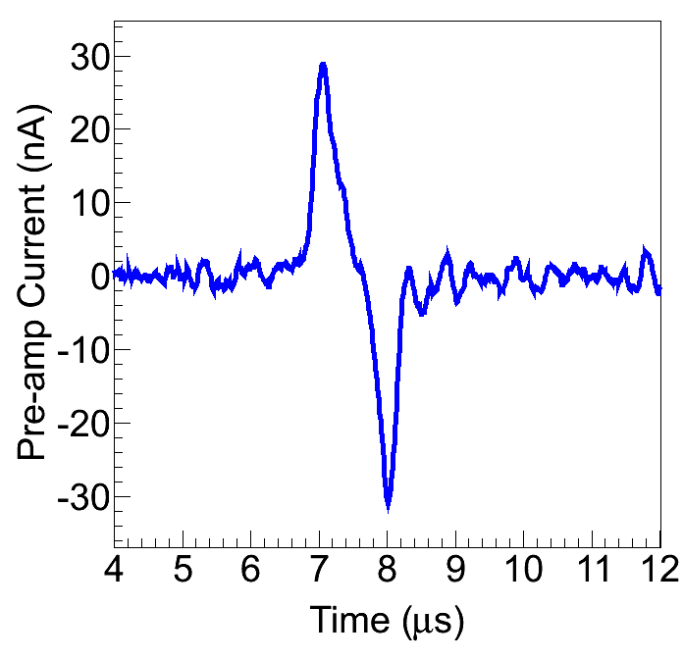
Ba⁺/Ba Deposition
Xe gas
Induction Plates
Pulsed Ba⁺
Ion Beam
Sapphire Window (11 K)
Retract Faraday cup during Ba⁺ pulse deposit.
Induction signal is read out during deposit.

Slide 26
To spectrometer/CCD
Xe gas
Filter
50 mm Camera Lens
Tunable Dye Laser
Pulsed Ba⁺
Ion Beam
Sapphire Window (11 K)

Slide 27
To spectrometer/CCD
Xe gas
Filter
50 mm Camera Lens
Tunable Dye Laser
Pulsed Ba⁺
Ion Beam
Sapphire Window (11 K)
Some neutralization of Ba⁺ in SXe

Slide 28
To spectrometer/CCD
Xe gas
Filter
50 mm Camera Lens
Tunable Dye Laser
Pulsed Ba⁺
Ion Beam
Sapphire Window (11 K)
Some neutralization of Ba⁺ in SXe
Samples are evaporated by heating sapphire window to 100 K

Slide 29
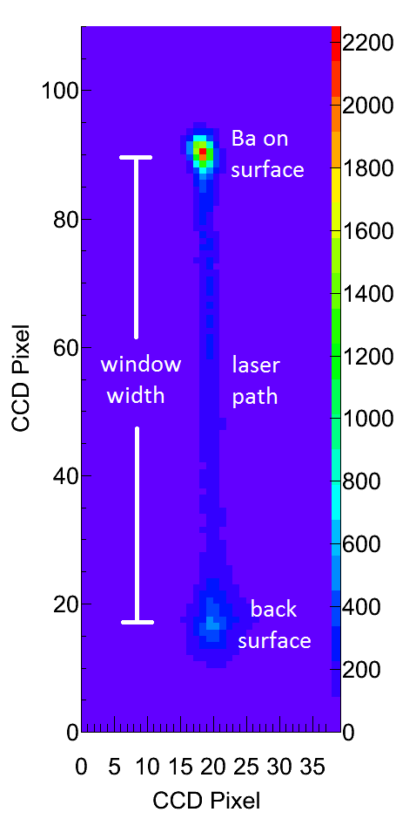
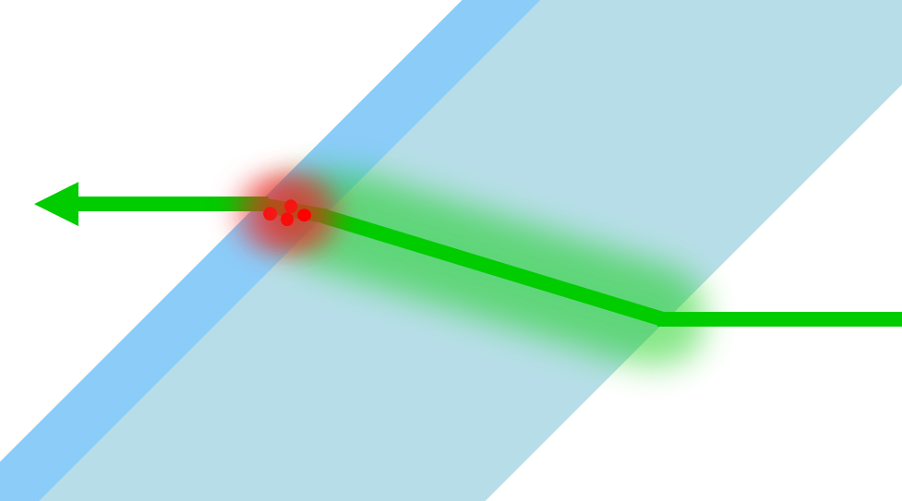
Imaging Ba in SXe on Cold Sapphire Window
Image is from above
cross-sectional side view
Laser
Ba
SXe
Sapphire Window
Laser

Slide 30
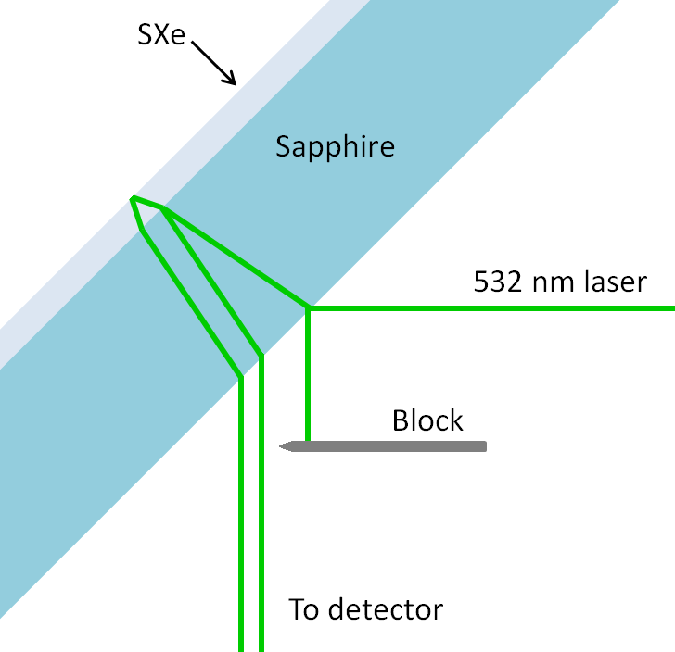
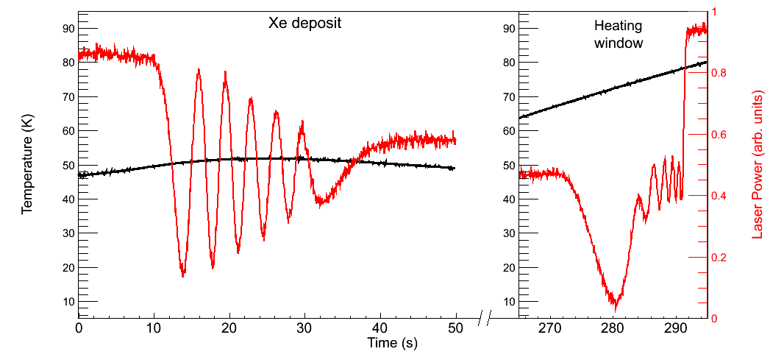
Measuring Xe matrix growth rate using interference fringes:
Xe deposit at 50 K
Observe same number of fringes when evaporating sample
Deposition rate of ~30 nm/s

Slide 31
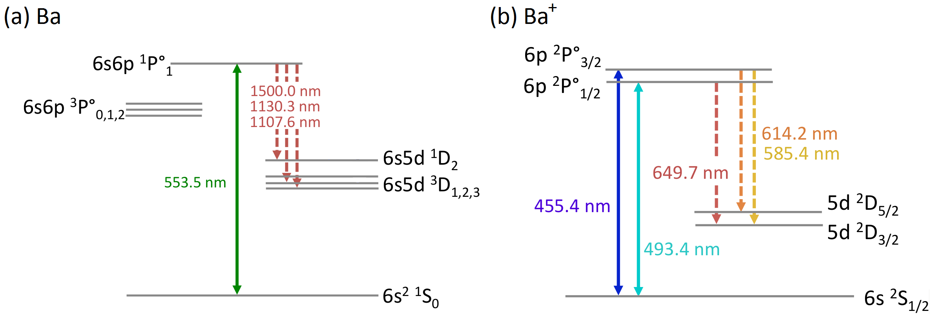
Ba and Ba⁺ Transitions in Vacuum
Ba
Ba⁺
~1 in 330 decays from ¹P₁ state are into metastable D states
~1 in 4 decays from ²P_{1/2} state are into metastable D state

Slide 32
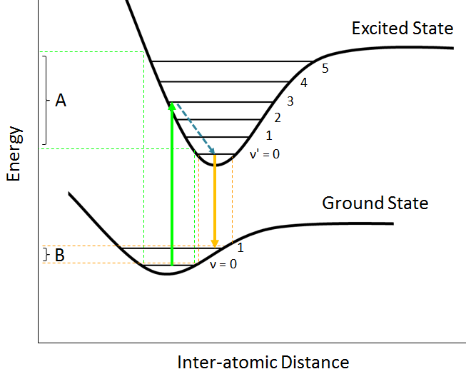
Interactions with neighboring host atoms (xenon)
Ba/Xe interaction is different in ground vs. excited state:
Franck-Condon principle:
Strongest excitation occurs to vibrational states whose wavefunctions overlap
Shifts and broadening in absorption (A) and emission (B)

Slide 33

Interactions with neighboring host atoms (xenon)
Ba in solid argon
Ba in solid xenon
Phys. Rev. A 91, 022505 (2015).
Excitation and emission are broadened
Excitation is shifted from vacuum wavelength
Emission is shifted from excitation

Slide 34
Interactions with neighboring host atoms (xenon)
Rate changes:
Non-radiative, e.g. crossing of potential energy curves
Radiative, e.g. parity change

Slide 35

Matrix Sites
Matrix effects (shifts, broadening, and transition rates) can be matrix site dependent.
Ba
Emission from Ba occupying different sites

Slide 36
Part 1: Spectroscopy

Slide 37

Emission of Ba in Solid Xe
b
c
Peaks observed at:
570 nm
577 nm
591 nm
601 nm
619 nm
670 nm
d
a
e
f

Slide 38

Excitation Spectra of Ba Emission Peaks

Slide 39


Thermal History Dependence
Matrix site populations can depend on thermal history:
Deposits at higher temperature (50 ± 5 K) result in larger 577-nm and 591-nm.
All observation is at 11 K
Deposit at 11 K
Deposit at 52 K
Images of 619-nm Ba fluorescence in focused laser (discussed later):
619-nm signal also higher w/ 50 ± 5 K deposit.

Slide 40




Annealing
564 nm laser excitation
Gain in 577-nm and 619-nm peaks after Cycle 1 (to 39 K), with modest loss in 591-nm.
Loss in fluorescence after Cycle 3 (to 48 K).
Overall, fluorescence is highest at 11 K.

Slide 41



Bleaching
Decay of Fluorescence w/ Laser Exposure
Spectra of Ba in SXe at different moments in time:
556.9 nm Laser
562.6 nm Laser
566.3 nm Laser
Rapid bleaching in 570-nm, 577-nm, 591-nm peaks.
619-nm and 670-nm peaks do not bleach at this laser intensity

Slide 42

Bleaching
Decay of Fluorescence w/ Laser Exposure
What causes bleaching?
Likely: optical pumping into metastable states, as in Ba in vacuum:
Bleaching is an obstacle for observing single atoms in these matrix sites: need more photons/atom.
Re-pumping with IR lasers may be required for continued fluorescence cycle.

Slide 43



Bleaching Model
$\frac{dN1}{dt}=−W12$N₁ + A₂₁N₂ + A₃₁N₃ + A₄₁N₄ + A₅₁N₅
$\frac{dN2}{dt}=W12$N₁ – (A₂₁ + A₂₃ + A₂₄ + A₂₅) N₂
$\frac{dN3}{dt}=$A₂₃N₂ – A₃₁N₃
$\frac{dN4}{dt}=$A₂₄N₂ – A₄₁N₄
$\frac{dN5}{dt}=$A₂₅N₂ – A₅₁N₅
N₁ + N₂ + N₃ + N₄ + N₅ = N_{atoms}
Rates in vacuum:
A₂₁=1.2x10⁸ s⁻¹
A₂₃=2.5x10⁵ s⁻¹
A₂₄=1.1x10⁵ s⁻¹ branching ratio 0.003
A₂₅=3.1x10³ s⁻¹
A₃₁=5 s⁻¹
A₄₁=0.014 s⁻¹ very slow metastable decay
A₅₁=0.017 s⁻¹
Compare numerical solution to above equations (normalized) to 591-nm Ba fluorescence data:
Disagreement may be due to altered rates in SXe
Agreement for first ~200 excitations
Still, re-pump lasers may eliminate/reduce bleaching.
# Excitations

Slide 44



Re-pump Attempts
w/ Inexpensive and On-hand Lasers
Higher-level states may provide re-pump paths (in addition to direct IR transitions).
e.g., 659.7 nm used along with 1130.0 nm and 1500.0 nm for
Ba MOT in Phys. Rev. A 79, 041402(R) (2009)
Ba in Vacuum
591-nm fluorescence vs. time w/ and w/o additional lasers:
No positive effect from these additional lasers (only increased bleaching)
Green: 555 nm (dye)
IR: 1064 nm (Nd:YAG)
+ 1550 nm (diode)
Red: 657 nm (diode)
Blue: 473 nm (dye)
Violet: 406 nm (Kr ion laser)

Slide 45

Bleaching of 619-nm Peak
619-nm fluorescence counts from a focused laser:
Much higher excitation rate due to focused laser
# Excitations
Though some bleaching is observed with the higher 0.61 mW laser power, the long-lasting 619-nm fluorescence is intriguing for single-atom detection w/o the need for re-pump lasers…

Slide 46



Blue Excitation: Candidate Ba⁺ Lines
Emission of Ba⁺ deposit w/ 468.25-nm excitation:
Ba⁺ in vacuum:
a
e
f
d
b
c
Excitation spectra for emission peaks:
(a)
(b)
(c)
(d)
(e)
(f)
Similarity between excitation spectra for
532 nm line and 635 nm line suggests they are related, and could be fluorescence of P→S and P→D, respectively, for Ba⁺.

Slide 47
Part 2: Imaging

Slide 48

Band-pass Filters for Imaging
620-nm band-pass
For 619-nm peak
586-nm band-pass
For 577-nm and 591-nm peaks together

Slide 49


Calculating # Ba atoms in focused laser region
Ba⁺ ion pulses:
Due to unknown neutralization fraction
From calibrated Faraday signal
Per pulse of ion beam:
#atoms ≤ #ions = [charge/(1.6×10⁻¹⁹ C)]/m² × Laser Area
Simulated laser spot of radii w_{x} × w_{y} = 2.06μm × 2.66 μm:
Two definitions for number of atoms:
Those instantaneously illuminated by laser spot
8.6 μm²
Total illuminated over vibrations
40 μm²
vibrations
2)
Laser spot size overlain on cryostat vibration data:
μm
μm

Slide 50
Calculating # Ba atoms in focused laser region
Ba⁺ ion pulses:
Due to unknown neutralization fraction
From calibrated Faraday signal
Per pulse of ion beam:
#atoms ≤ #ions = [charge/(1.6×10⁻¹⁹ C)]/m² × Laser Area
Simulated laser spot of radii w_{x} × w_{y} = 2.06μm × 2.66 μm:
Two definitions for number of atoms:
Those instantaneously illuminated by laser spot
8.6 μm²
Total illuminated over vibrations
40 μm²
vibrations
2)
Laser spot size overlain on cryostat vibration data:
μm
μm

Slide 51







Imaging 591-nm Fluorescence w/ Focused Laser, ~1 mW
50 msec.
100 msec.
200 msec.
700 msec.
~4.5 sec.
~3 min.
Cross-section
at focus position:
Hole-bleaching occurs rapidly at high laser intensity.
Need to use low laser power to image only atoms within focused laser region.

Slide 52


Imaging 577-nm and 591-nm Fluorescence
w/ Focused Laser, 0.03 µW
≤ 2700 Ba atoms
Frame 1
Frame 3
…
Only slight bleaching at this intensity in 100-s exposures
Backgrounds are negligible at this intensity

Slide 53



Imaging 619-nm Fluorescence
Backgrounds become important at high laser intensity
Image w/ 620-nm
band-pass filter:
Sapphire Emission Spectrum:
Band-pass
Filter
Surface Background Spectrum:
Band-pass
Filter
Broad and sharp emission from Cr³⁺ impurities in sapphire window
Dominant background
Bleaches with laser exposure – can be reduced
Minimized by high-purity windows
Only low tail is passed by filter

Slide 54



Bleaching of the Surface Background
Surface background counts during pre-bleaching process:
~1 hour pre-bleaching

Slide 55

Imaging 619-nm Fluorescence
Xe-only deposits are observed in between Ba+ deposits to monitor surface background:
Ba signal is clear over background

Slide 56

Imaging 619-nm Fluorescence
Xe-only deposits are observed in between Ba+ deposits to monitor surface background:
Ba signal is clear over background

Slide 57

Imaging 619-nm Fluorescence
Xe-only deposits are observed in between Ba+ deposits to monitor surface background:
Single-atom signal is distinguishable by eye!

Slide 58



Imaging 619-nm Fluorescence
619-nm signal vs. ions in laser for two different experiments:
8.6 μm² Laser Region
60-s Exposures
39 μm² Laser Region
3-s Exposures
Images of blue points are shown
1500 ± 160 counts/mW from single atoms w/ 8.6 μm² laser region, 60-s exposures
Linear relationship rules out Ba₂ molecule

Slide 59

Imaging 619-nm Fluorescence
No Ba signal after sample evaporation and re-deposit of Xe-only
Even in large Ba deposits:
Very important result for a Ba tagging cold probe in nEXO

Slide 60


Next Step: Scanned Images of Ba atoms
Scan laser by scanning focusing lens:
Each camera exposure is for a position in a grid:
See peaks as laser moves over single atoms
x/y translation stages

Slide 61





First Attempts at Scanned Images
≤ 0.48 Ba/step
Xe-only
≤ 0.63 Ba/step
≤ 5.7 Ba/step
Trend-line single-Ba signal level
(10-s exposure)
Need to reduce surface background:
Separation by fluorescence lifetimes
Acid etching
Synchronize laser gating w/ vibrations:
Step-to-step variation in surface BG competes w/ single-atom signal level:
×

Slide 62
Conclusions
Spectroscopy of Ba in SXe has been studied with attention to:
Temperature history effects
Bleaching
Imaging of Ba in SXe w/ sensitivity to:
~10³ atoms w/ 577- and 591-nm lines
Single atoms w/ 619-nm line!
Single-atom level sensitivity is a major step toward Ba tagging in nEXO, and the future of neutrino physics!

Slide 63
Thx!

Slide 64



Slide 65


Ion Extraction from Liquid Xenon
Currently underway in parallel, by Chris Chambers and Adam Craycraft
Cold Probe
Barium Source
Liquid Xenon Cell
Cold Probe

Slide 66
9.9 events in 2 sigma is consistent w/ null at 1.2 sigma level

Slide 67

Backgrounds vs. Temperature:

Slide 68


Cryostat Vibrations:

